Slide 1
Polar Codes
Group 30 Mentor: Dharmi Patel
Prof. Yash Vasavada

Slide 2
Honour Code
We declare that
~The work that we are presenting is our own work.
~ We have not copied the work (the code, the results, etc.) that someone else has done.
~ Concepts, understanding and insights we will be describing are our own.
~ We make this pledge truthfully. We know that violation of this solemn pledge can carry grave consequences.

Slide 3
Group Members
1. HIYA MODI (202301011)
2. PARSHV JOSHI (202301039)
3. ARHAAN SHAH (202301048)
4. DHRUV JIGNESHKUMAR PATEL (202301095)
5. DEVANSH SHAH (202301136)
6. OM PATEL (202301163)
7. SANAGADHIYA RADHIKA(202301184)
8. PATEL DIYA MUKESHKUMAR(202301216)
9. SHARNAM SHAH (202301247)
10. PRASHAM SHAH (202301252)

Slide 4
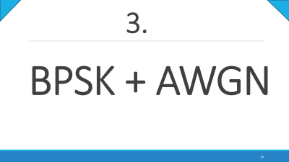
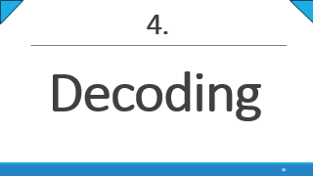
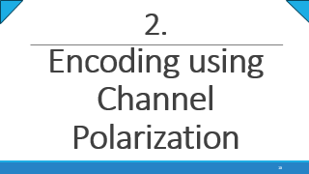
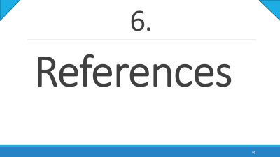
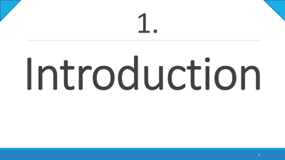
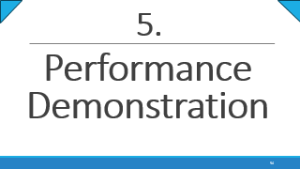
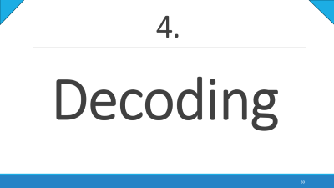
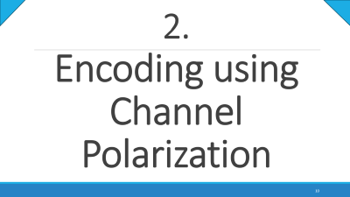
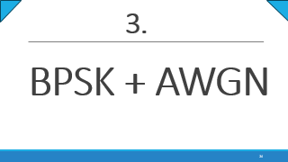
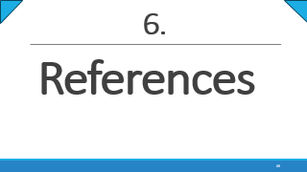
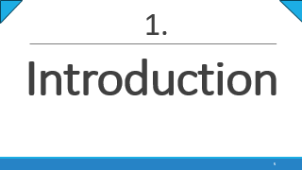
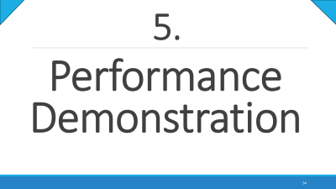
Table of Contents

Slide 5
Introduction
1.

Slide 6
Things we will cover here
1.Introduction
History of Polar Codes
Analogy
Block Diagram for Polar Codes

Slide 7
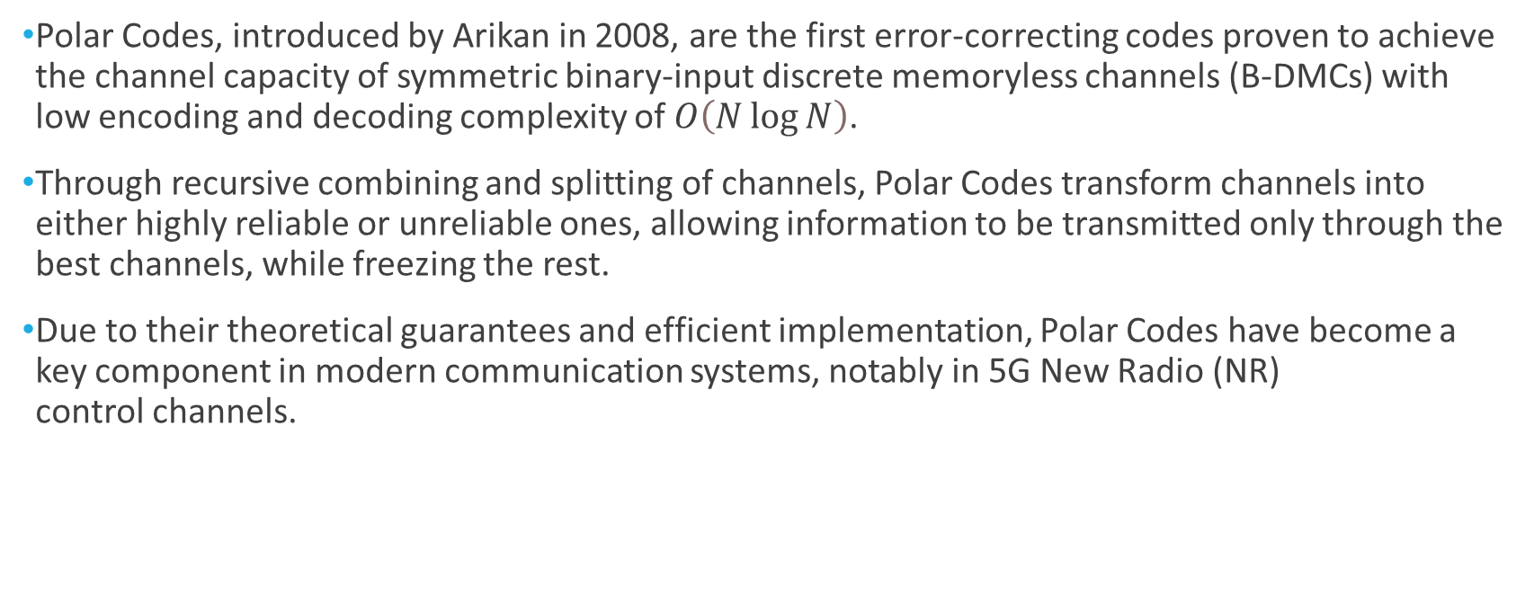
A) History of Polar Codes
1.Introduction/History
Polar Codes, introduced by Arikan in 2008, are the first error-correcting codes proven to achieve the channel capacity of symmetric binary-input discrete memoryless channels (B-DMCs) with low encoding and decoding complexity of $O\left(N\log{N}\right)$.
Through recursive combining and splitting of channels, Polar Codes transform channels into either highly reliable or unreliable ones, allowing information to be transmitted only through the best channels, while freezing the rest.
Due to their theoretical guarantees and efficient implementation, Polar Codes have become a key component in modern communication systems, notably in 5G New Radio (NR) control channels.

Slide 8
B) Analogy
1.Introduction/Analogy
Now, to understand the gist of Polar Codes, we have presented an interesting analogy.
You can think of them as being Single-Minded Altruists, people who focus all their effort, time and energy committed to singular meaningful cause for the benefit of others.
Similarly, Channel Polarization splits channel into goods and bads, i.e. noiseless and noisy channels. And instead of wasting energy on all channels equally, they devote their full resources into the “good” (noiseless) channels.

Slide 9
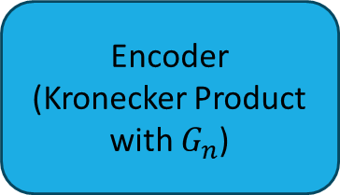
C) Block Diagram for Polar Codes
1.Introduction/Block Diagram
Message Bits
Polarisation
Encoder
(Kronecker Product with $G_{n}$)
BPSK
(1 → -1
0→ +1)
Reliability
sequence
Decoder
AWGN
(adds noise)

Slide 10
2.
Encoding using Channel Polarization

Slide 11
We will Cover the below Topics
2.Encoding
a. Polar Transform and Kronecker Product
b. Tree Diagram Representation
c. Channel Splitting / Reliability Sequence
d. Bhattacharyya Parameter
e. Encoding Algorithm

Slide 12
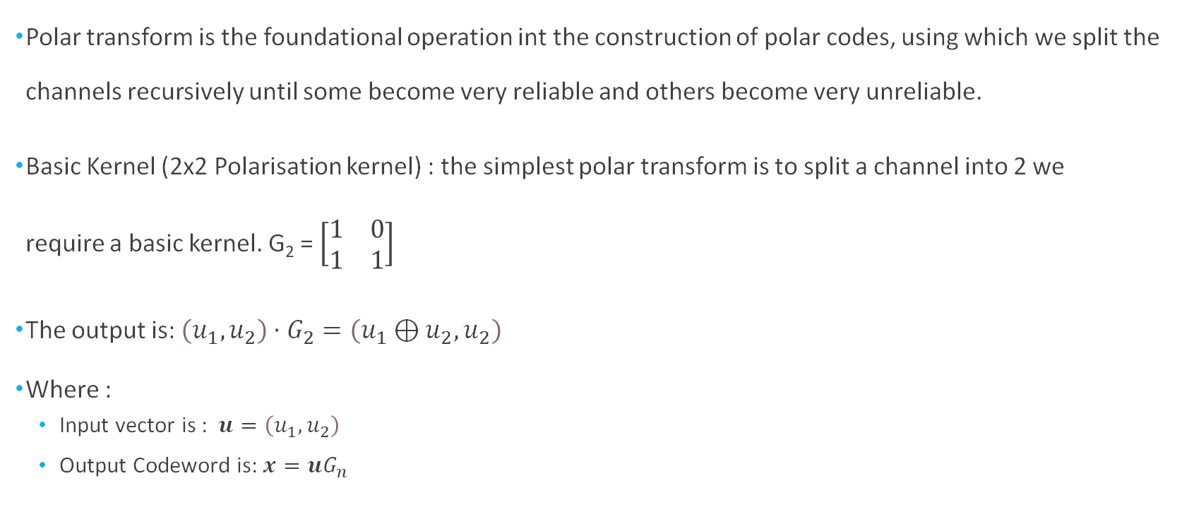
A) Polar Transform and Kronecker Product
2.Encoding/Polar Transform
Polar transform is the foundational operation int the construction of polar codes, using which we split the channels recursively until some become very reliable and others become very unreliable.
Basic Kernel (2x2 Polarisation kernel) : the simplest polar transform is to split a channel into 2 we require a basic kernel. G₂ = $\left[\begin{matrix}1 & 0 \\ 1 & 1\end{matrix}\right]$
The output is: $\left(u_{1},u_{2}\right)⋅G_{2}=\left(u_{1}⊕u_{2},u_{2}\right)$
Where :
Input vector is : $u=\left(u_{1},u_{2}\right)$
Output Codeword is: $x=uG_{n}$

Slide 13
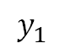
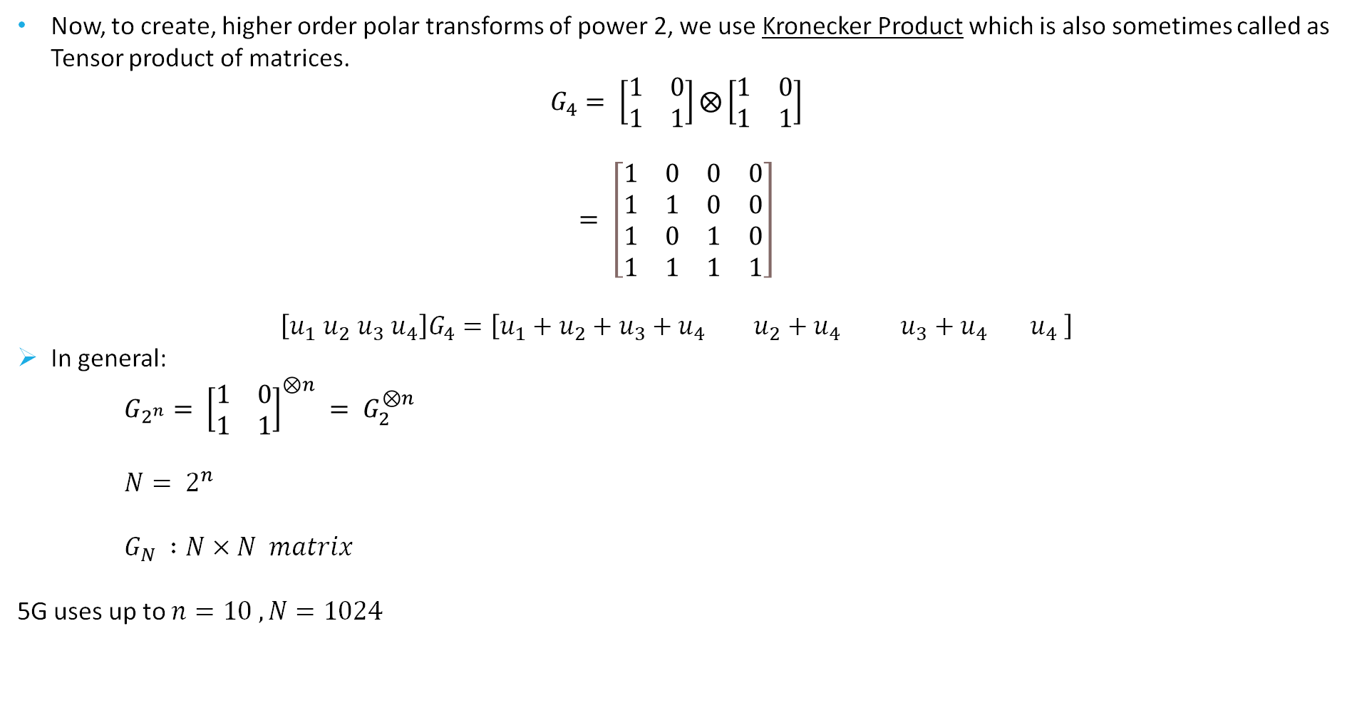
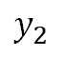
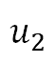
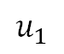
2.Encoding/Polar Transform
Now, to create, higher order polar transforms of power 2, we use Kronecker Product which is also sometimes called as Tensor product of matrices.
$$G_{4}= \left[\begin{matrix}1 & 0 \\ 1 & 1\end{matrix}\right]⨂\left[\begin{matrix}1 & 0 \\ 1 & 1\end{matrix}\right]$$
$$= \left[\begin{matrix}1 & 0 & 0 & 0 \\ 1 & 1 & 0 & 0 \\ 1 & 0 & 1 & 0 \\ 1 & 1 & 1 & 1\end{matrix}\right]$$
$$\left[u_{1} u_{2} u_{3} u_{4}\right]G_{4}=\left[u_{1}+u_{2}+u_{3}+u_{4} u_{2}+u_{4} u_{3}+u_{4} u_{4} \right]$$
In general:
$G_{2^{n}}= {\left[\begin{matrix}1 & 0 \\ 1 & 1\end{matrix}\right]}^{⊗n} = G_{2}^{⊗n}$
$N= 2^{n}$
$G_{N} :N×N matrix$
5G uses up to $n=10 , N=1024$
$$u_{1}$$
W
$$y_{1}$$
$$u_{2}$$
W
$$y_{2}$$

Slide 14
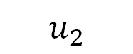

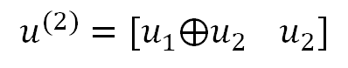
B) Tree Diagram Representation
2.Encoding/Tree Diagram
$$u^{(2)}=[u_{1}⨁u_{2} u_{2}]$$
$$u_{1}$$
$$u_{2}$$

Slide 15
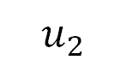
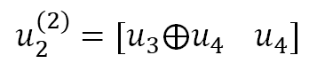
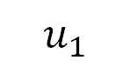
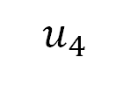
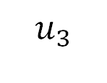
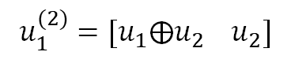
2.Encoding/Tree Diagram
$u^{(4)}=\left[u_{1}^{\left(2\right)}⨁u_{2}^{\left(2\right)} , u_{2}^{\left(2\right)} \right]=[u_{1}⨁u_{2}⨁u_{3}⨁u_{4 },u_{2}⨁u_{4 },u_{3}⨁u_{4 },u_{4 }$]
$$u_{1}^{(2)}=[u_{1}⨁u_{2} u_{2}]$$
$$u_{2}^{(2)}=[u_{3}⨁u_{4} u_{4}]$$
$$u_{1}$$
$$u_{2}$$
$$u_{3}$$
$$u_{4}$$

Slide 16
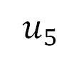
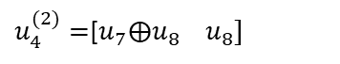
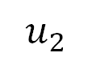
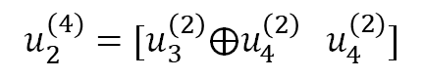
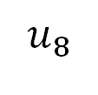
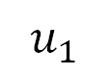
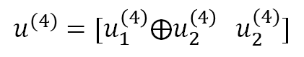
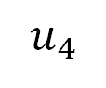
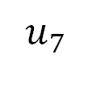
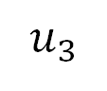
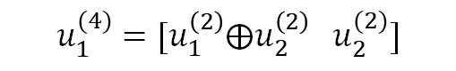
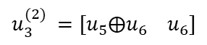

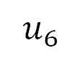
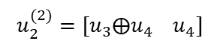
2.Encoding/Tree Diagram
$$u^{(4)}=[u_{1}^{\left(4\right)}⨁u_{2}^{\left(4\right)} u_{2}^{(4)}]$$
$$u_{1}^{(4)}=[u_{1}^{\left(2\right)}⨁u_{2}^{\left(2\right)} u_{2}^{(2)}]$$
$$u_{2}^{(4)}=[u_{3}^{\left(2\right)}⨁u_{4}^{\left(2\right)} u_{4}^{(2)}]$$
$$u_{2}^{(2)}=[u_{3}⨁u_{4} u_{4}]$$
$$u_{1}^{(2)}=[u_{1}⨁u_{2} u_{2}]$$
$$u_{3}^{(2)} =[u_{5}⨁u_{6} u_{6}]$$
$u_{4}^{(2)}=$[$u_{7}⨁u_{8} u_{8}]$
$$u_{1}$$
$$u_{2}$$
$$u_{3}$$
$$u_{4}$$
$$u_{5}$$
$$u_{6}$$
$$u_{7}$$
$$u_{8}$$

Slide 17
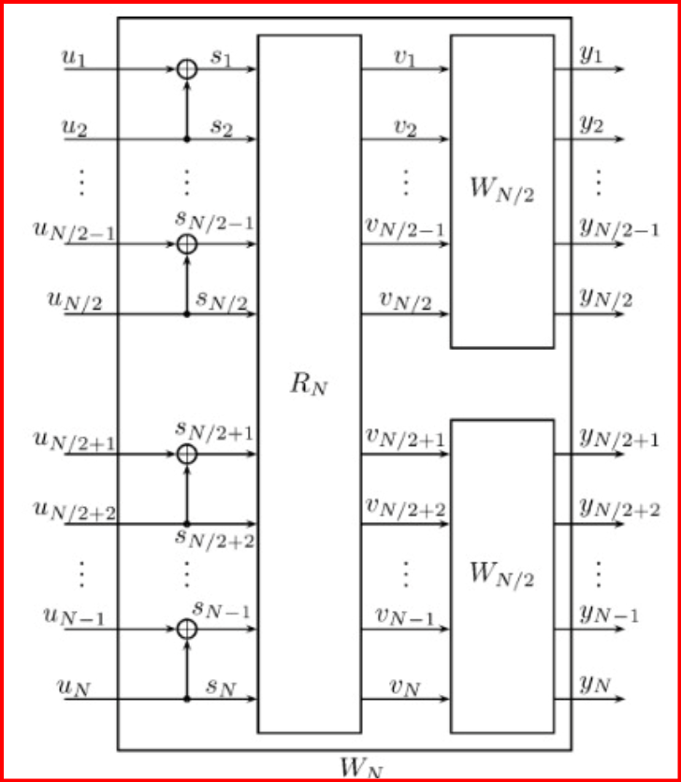
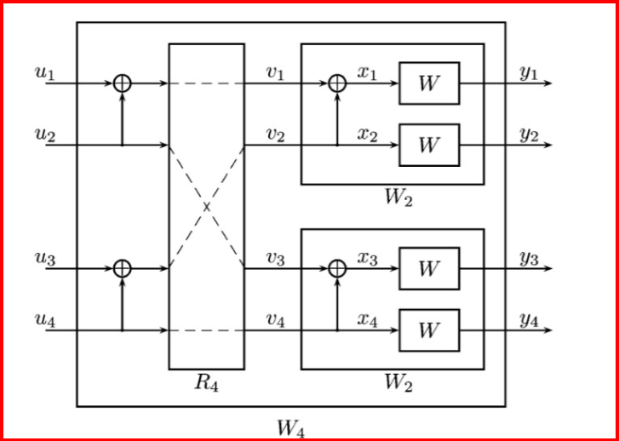
C) Channel Splitting / Reliability Sequence
2.Encoding/Channel Splitting and Reliability Sequence
Here R represents the bit reversal of message with permutation blocks

Slide 18
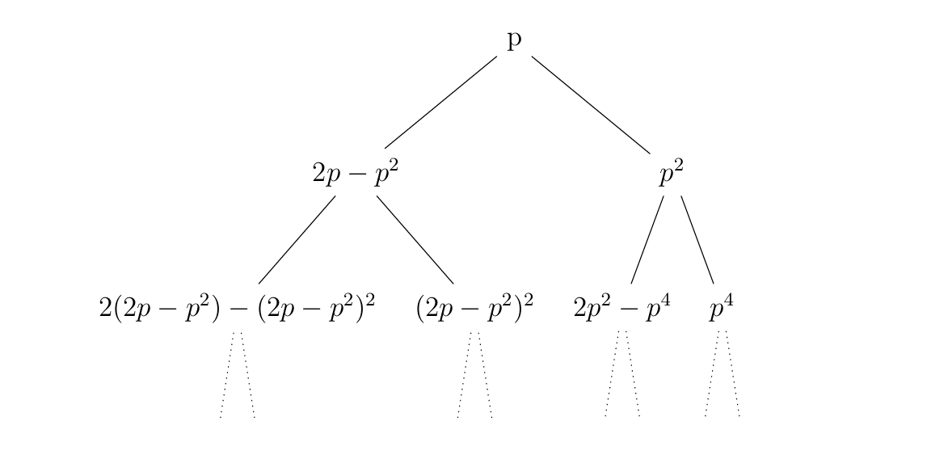
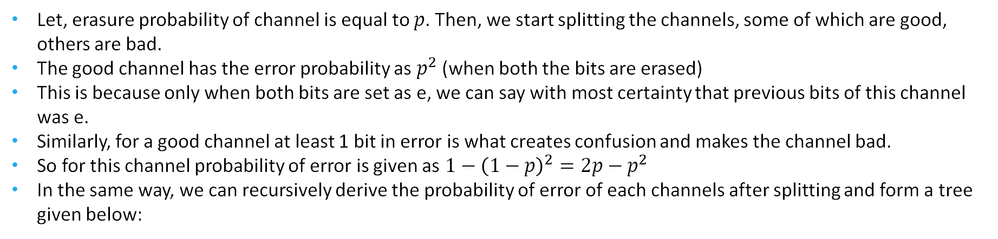
2.Encoding/Channel Splitting and Reliability Sequence
Let, erasure probability of channel is equal to $p$. Then, we start splitting the channels, some of which are good, others are bad.
The good channel has the error probability as $p^{2}$(when both the bits are erased)
This is because only when both bits are set as e, we can say with most certainty that previous bits of this channel was e.
Similarly, for a good channel at least 1 bit in error is what creates confusion and makes the channel bad.
So for this channel probability of error is given as $1−{\left(1−p\right)}^{2}=2p−p^{2}$
In the same way, we can recursively derive the probability of error of each channels after splitting and form a tree given below:

Slide 19
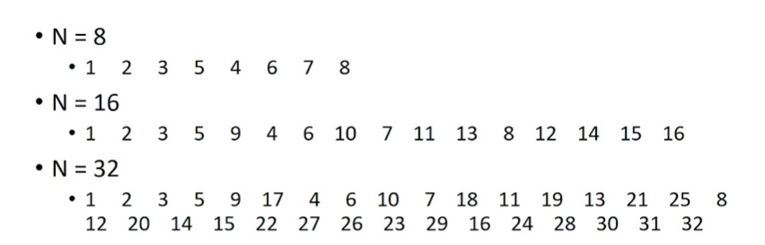
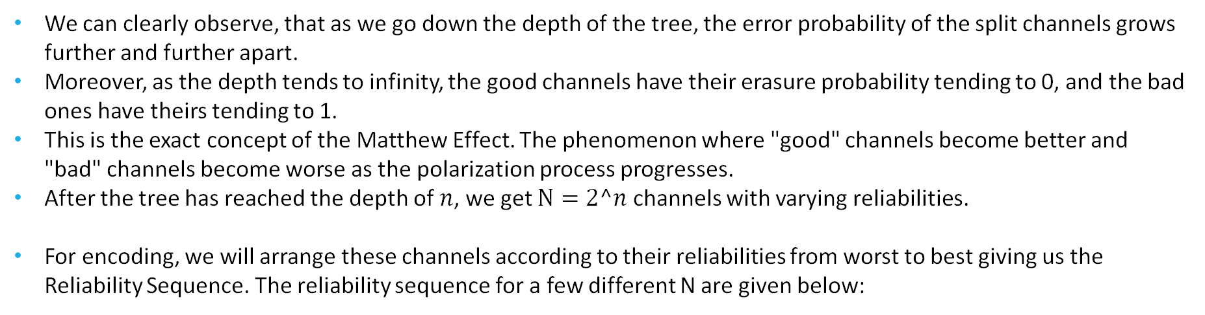
2.Encoding/Channel Splitting and Reliability Sequence
We can clearly observe, that as we go down the depth of the tree, the error probability of the split channels grows further and further apart.
Moreover, as the depth tends to infinity, the good channels have their erasure probability tending to 0, and the bad ones have theirs tending to 1.
This is the exact concept of the Matthew Effect. The phenomenon where "good" channels become better and "bad" channels become worse as the polarization process progresses.
After the tree has reached the depth of $n$, we get $N=2^n$ channels with varying reliabilities.
For encoding, we will arrange these channels according to their reliabilities from worst to best giving us the Reliability Sequence. The reliability sequence for a few different N are given below:

Slide 20
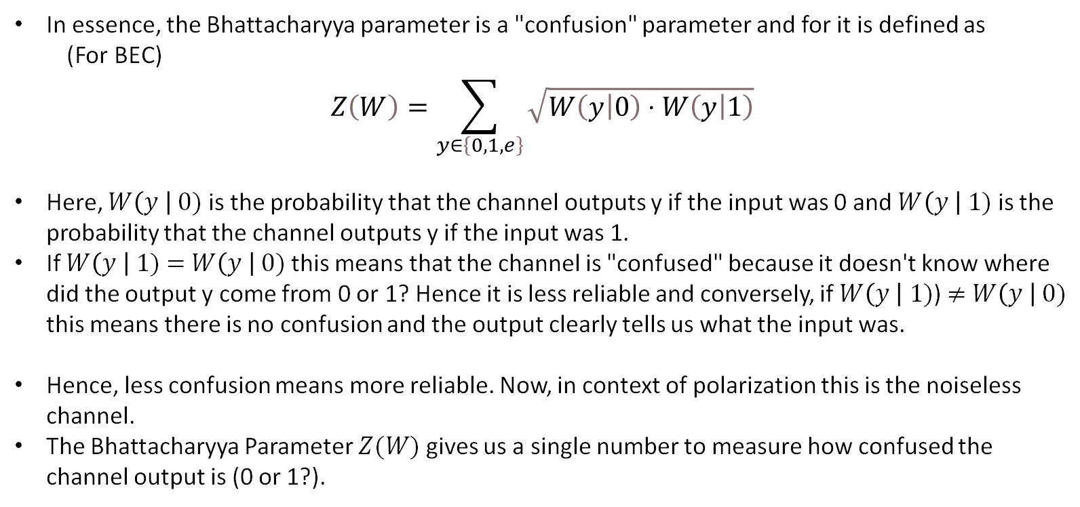
2.Encoding/Bhattacharyya Parameter
D) Bhattacharyya Parameter
In essence, the Bhattacharyya parameter is a "confusion" parameter and for it is defined as
(For BEC)
$$Z\left(W\right)=\sum_{y∈\left\{0,1,e\right\}}{\sqrt{W\left(\left.y\right|0\right)⋅W\left(\left.y\right|1\right)}}$$
Here, $W\left(y \right| 0)$ is the probability that the channel outputs y if the input was 0 and $W\left(y \right| 1)$ is the probability that the channel outputs y if the input was 1.
If $W\left(y \right| 1)$ $=$ $W\left(y \right| 0)$ this means that the channel is "confused" because it doesn't know where did the output y come from 0 or 1? Hence it is less reliable and conversely, if $W\left(y \right| 1)$) $≠$ $W\left(y \right| 0)$ this means there is no confusion and the output clearly tells us what the input was.
Hence, less confusion means more reliable. Now, in context of polarization this is the noiseless channel.
The Bhattacharyya Parameter $Z(W)$gives us a single number to measure how confused the channel output is (0 or 1?).

Slide 21
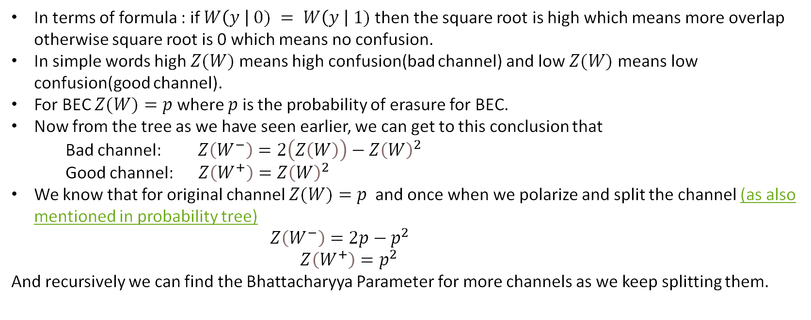
2.Encoding/Bhattacharyya Parameter
In terms of formula : if $W\left(y \right| 0) = W\left(y \right| 1)$then the square root is high which means more overlap otherwise square root is 0 which means no confusion.
In simple words high $Z(W)$means high confusion(bad channel) and low $Z(W)$means low confusion(good channel).
For BEC $Z(W)=p$where $p$ is the probability of erasure for BEC.
Now from the tree as we have seen earlier, we can get to this conclusion that
Bad channel:$Z\left(W^{−}\right)=2\left(Z\left(W\right)\right)−Z{\left(W\right)}^{2}$
Good channel: $Z\left(W^{+}\right)=Z{\left(W\right)}^{2}$
We know that for original channel $Z(W)=p$and once when we polarize and split the channel (as also mentioned in probability tree)
$Z\left(W^{−}\right)=2p−p^{2}$
$$Z\left(W^{+}\right)=p^{2}$$
And recursively we can find the Bhattacharyya Parameter for more channels as we keep splitting them.

Slide 22


2.Encoding/Bhattacharyya Parameter

Slide 23

E) Encoding Algorithm
2.Encoding/Encoding Algorithm
Now the question arises why did we find out the reliability sequence ??
We need it to find the noisy useless channels to successful perform encoding.
Algorithm :
To Encode (N,K) Polar Code [K information bits] and [N = $2^{n}$ message bits]
Compute the Bhattacharyya Parameter for all N channels and rank them form worst to best
Choose the K most reliable channels
Assign the K information bits, to the chosen channels and assign 0 to the rest (frozen) channels
Now compute x $=uG_{N}$
Hence the Encoding Time Complexity is $O\left(N\log{N}\right)$.

Slide 24
3.
BPSK + AWGN

Slide 25
BPSK Modulation
3. BPSK + AWGN
Within a Phase Shift Key modulator, each individual bit in the codeword being encoded is mapped to a corresponding phase value.
In a BPSK, we have two separate phases at 0° and 180° to maximize the gap between both bits and reduce the effect of noise.
Mapping:
Bit b=0 has ϕ=0 thus having a signal of +1 volts
Bit b=1 has ϕ=π thus having a signal of -1 volts

Slide 26
AWGN Channel
3. BPSK + AWGN
Once the encoded codeword has passed through the BPSK modulation, transmission occurs and it is passed from the sender to the receiver. Due to the imperfect nature of the transmission, Additive White Gaussian Noise (AWGN) is introduced and affects our signal.
Since the noise is additive:
r(t)=s(t)+n(t)
Since the noise is follows a gaussian distribution:
n(t)∼N(0,σ^2)

Slide 27

Combined Noise: AWGN + Laplace + Uniform
3. BPSK + AWGN
Three noise components are generated independently:
Gaussian Noise ($n_{1}$) $n_{1}= \sqrt{v} ×randn\left(1,N\right)$
Laplace Noise ($n_{2}$) $n_{2}=b×\left\{\begin{aligned}\log\left(2U\right) if U<0.5 \\ −\log\left(2\left(1−U\right)\right) if U≥0.5\end{aligned} U \sim Uniform(0,1)\right.$
Uniform Noise ($n_{3}$) $n_{3}=a ×\left(2 ×rand\left(1,N\right)−1\right)$
Total Noise: n = $n_{1}$ + $n_{2}$ + $n_{3}$
Gaussian noise $n_{1}$, has mean 0 and variance $v$
Laplce noise $n_{2}$, has mean 0 and variance $2b^{2}$
Uniform noise $n_{3}$, has mean 0 and variance $\frac{a^{2}}{3}$
Total Noise will have, mean 0 and variance =$v$ + $2b^{2}$+ $\frac{a^{2}}{3}=3v$

Slide 28


3. BPSK + AWGN
The characteristic equations are:
$$For n_{1} \sim N\left(0,v\right): φ_{n_{1}}\left(t\right)= e^{\frac{−vt^2}{2}}$$
F$or n_{2},Laplace with scale b= \sqrt{\frac{v}{2}} :φ_{n_{1}}\left(t\right)= \frac{1}{1+b^{2}t^{2}}=\frac{1}{1+\frac{v}{2}t^{2}}$
$$For n_{3} \sim Uniform\left(−a,a\right), a= \sqrt{3v} : φ_{n_{3}}\left(t\right)=\frac{\sin\left(at\right)}{at}=\frac{\sin\left(\sqrt{3v}\right)t}{\sqrt{3v}t}$$
Thus,
$φ_{n}\left(t\right)=e^{ut^{2}/2} × \frac{1}{1+\frac{v}{2}t^{2}} ×\frac{\sin\left(\sqrt{3v}\right)t}{\sqrt{3v}t}$

Slide 29



3. BPSK + AWGN
Mixed Noise approximates to AWGN according to Central Limit Theorem

Slide 30
4.
Decoding

Slide 31
We will cover the below topics
4.Decoding
a. Types of Decision
b. Soft-In Soft-Out (SISO) Decoder
c. Types of decoder
C1. Successive Cancellation (SC)
C2. Cyclic Redundancy Check Successive Cancellation List (CRC SCL)

Slide 32
A) Types of Decision
4. Decoding/Types of Decision
There are two Types of Decision:
Hard
Soft

Slide 33

1. Hard Decision
4.Decoding/Types of Decision/Hard
A hard decision involves making a binary determination (0 or 1) about the value of a received bit based solely on a threshold, without considering the reliability or confidence level of the decision.
Example:
Say the channel output is:$y=\left[+3.2 , −1.7 , +0.9 , −2.5\right]$
Using hard decisions, this becomes: $u=\left[1,0,1,0\right]$
Hard decisions are the foundation of the original SC decoding algorithm proposed by Arikan. The decoder makes decisions sequentially, using the frozen bits and the polarized channel structure to estimate information bits.

Slide 34

2. Soft Decision
4.Decoding/Types of Decision/Soft
A soft decision involves interpreting the received channel output as a probability or likelihood (e.g., a log-likelihood ratio, LLR) that reflects the confidence in the bit value, rather than a binary choice. This allows the decoder to use more detailed channel information.
Example:
Using the same received values: $y=\left[3.2,−1.7,0.9,−2.5\right]$
These values are directly used in decoding as LLRs.
Soft decision decoding is a key enhancement in advanced polar code decoding algorithms, such as list decoding and successive cancellation list (SCL) decoding.

Slide 35

B) Soft-In Soft-Out (SISO) Decoder
4.Decoding/SISO
SISO Decoding refers to a decoding technique that takes soft inputs from the channel and produces soft outputs, which represent the reliability of the decoded bits.
Soft - Input:
The decoder accepts probabilistic input information, typically in the form of Log-Likelihood Ratios (LLRs), where each LLR $L\left(x\right)=\log\left(\frac{P\left(x=0 |y\right)}{P\left(x=1|y\right)}\right)$. This input reflects how confident we are that a bit is 0 or 1.
Soft – Output:
Instead of outputting just hard decisions (like 0 or 1), the decoder outputs updated LLRs that can be passed to other decoders in iterative schemes.
In iterative decoding, one decoder passes soft output to another decoder as soft input—this process repeats for better performance.
SISO decoding improves error correction by retaining and refining bit reliability instead of just making hard 0/1 decisions early.

Slide 36

C) Types of decoder
4.Decoding/Types of decoder
We have used two methods to decode the received codeword:
1. Successive Cancellation Decoder(SC) - The Successive Cancellation decoder is a low-complexity, sequential decoding algorithm for polar codes that estimates each transmitted bit${ u}_{i }(where i=1,2,…,N)$ by making a decision based on the received channel output $y$ and the decisions for the${ u}_{i : i−1 }.$
2. CRC aided Successive Cancellation List Decoder(CASCL) - A CRC-aided Successive Cancellation List decoder is an advanced decoding algorithm for polar codes that enhances the standard SC Decoding by maintaining a list of the candidate codewords and using a Cyclic Redundancy Check(CRC) to select the most likely correct codeword.

Slide 37

4.Decoding/Types of decoder
The key idea used for decoding in both algorithms is that we use the beliefs(L) obtained from the received bits to estimate the codeword bits and then we estimate the next codeword bits using the received beliefs and previously estimated codewords.
Let r1 and r2 be the received bits from the channel.
1. To estimate u1 (from $x_{1 } ⨁ x_{2}$):
Use the f-function(SISO decoder for SPC code):
$L=f\left(r_{1},r_{2}\right)= \operatorname{sgn}{(r_{1})}×\operatorname{sgn}\left(r_{2}\right)$ $×min(\left|r_{1}\right|,\left|r_{2}\right|$)
2. To estimate u2(given u1):
Use the g function (SISO decoder for RPC code):
$L=g\left(r_{1},r_{2},{\hat{u}}_{1} \right)=r_{2}$ + (1 -2 ${\hat{u}}_{1})×r_{1}$
Hard Decision Rule: In stage 1 the bit decision rule is as follows: for an information bit, if soft messages $L_{1,i}≥0$, then ${\hat{u}}_{i}=0,$ otherwise ${\hat{u}}_{i}=1 ;$ for a frozen bit, simply set it to a pre-determined value, for example, ${\hat{u}}_{i}=0$.

Slide 38
C1) Successive Cancellation Decoder(SC)
4.Decoding/Types of decoder/SC
1. We start from the root node, transmitting LLRs to the left child nodes using the f function till we reach the leaf node.
2. Once we reach the leaf node, we estimate the value of the codeword depending on the value of the LLR :
if the bit is frozen, the value of the bit will be set to 0.
else, the value of the bit will be set depending on the sign of the LLR, 0 if positive, 1 if negative.
3. We propagate the estimated codeword bit back to the parent and then transmit LLR(calculated using g function) to the right child node.
4. Estimate the value of right child node as in step 2.
5. We backpropagate the values of the right child node and then calculate the value of the parent node. After completing the overall backtracking, we get the entire estimated codeword.

Slide 39

4.Decoding/Types of decoder/SC
Example: For m $=2,$where both are message bits
$$[r_{1} r_{2}]=[−1.0345 1.2068]$$

Slide 40


4.Decoding/Types of decoder/SC
Example: For m $=2,$where both are message bits
$$[r_{1} r_{2}]=[−1.0345 1.2068]$$
$L=f(r_{1},$ $r_{2}$)

Slide 41



4.Decoding/Types of decoder/SC
Example: For m $=2,$where both are message bits
$$[r_{1} r_{2}]=[−1.0345 1.2068]$$
$L=f(r_{1},$ $r_{2}$)
$$L=−1.0345$$

Slide 42




4.Decoding/Types of decoder/SC
Example: For m $=2,$where both are message bits
$$[r_{1} r_{2}]=[−1.0345 1.2068]$$
$${\hat{u}}_{1}$$
1
$$L=−1.0345$$
$${\hat{u}}_{1}$$

Slide 43

4.Decoding/Types of decoder/SC
Example: For m $=2,$where both are message bits
$$[r_{1} r_{2}]=[−1.0345 1.2068]$$
$L=g(r_{1},$ $r_{2}, {\hat{u}}_{1})$
$${\hat{u}}_{1}$$
1
$${\hat{u}}_{1}$$

Slide 44

4.Decoding/Types of decoder/SC
Example: For m $=2,$where both are message bits
$$[r_{1} r_{2}]=[−1.0345 1.2068]$$
$L=g(r_{1},$ $r_{2}, {\hat{u}}_{1})$
$${\hat{u}}_{1}$$
1
$$L=2.2413$$
$${\hat{u}}_{1}$$

Slide 45


4.Decoding/Types of decoder/SC
Example: For m $=2,$where both are message bits
$$[r_{1} r_{2}]=[−1.0345 1.2068]$$
$${\hat{u}}_{2}$$
$${\hat{u}}_{1}$$
1
0
$$L=2.2413$$
$${\hat{u}}_{1}$$
$${\hat{u}}_{2}$$

Slide 46
4.Decoding/Types of decoder/SC
Example: For m $=2,$where both are message bits
$$[{\hat{u}}_{1}+{\hat{u}}_{2} {\hat{u}}_{2}]=[1 0]$$
$${\hat{u}}_{2}$$
$${\hat{u}}_{1}$$
1
0
$$L=2.2413$$
$${\hat{u}}_{1}$$
$${\hat{u}}_{2}$$

Slide 47












4.Decoding/Types of decoder/SC
Generalising for any $M$
Step L
Step R
Step U
$$M=2^{m}$$
$${\hat{[ U}}_{1 }{\hat{+U}}_{2}{ \hat{U}}_{2 }]$$
$$L=[L_{1},L_{2},…L_{m}]$$
M bits
$$f(L_{1:M/2}, L_{1+\text{M}\text{/2:}\text{M}})$$
$$g(L_{1:M/2}, L_{1+M/2:M},{\hat{U}}_{1})$$
$${\hat{U}}_{1 }$$
$${\hat{U}}_{2 }$$
$${\hat{U}}_{1}$$
$M/2$ Values
$M/2$ Values
$M/2$ Bits each
$M/2$ Bits

Slide 48

4.Decoding/Types of decoder/SC
For m = 16

Slide 49










4.Decoding/Types of decoder/SC
$r_{1}$ ${ r}_{2} { r}_{3}$ $r_{4}$
$$f$$
$$f$$
$$g$$
$$\hat{u_{1}}+\hat{u_{2}}$$
$$g$$
$$\hat{u_{2}}$$
$$f$$
$$g$$
$$f$$
$$g$$
$$\hat{u_{3}}$$
$$\hat{u_{1}}$$
$\hat{u_{1}}$ $\hat{u_{2}}$ $\hat{u_{3}}$ $\hat{u_{4}}$

Slide 50

C2) Successive Cancellation List
4.Decoding/Types of decoder/SCL
Pre-requisite:
Decision Metric (DM)
Calculated at each leaf node
Let $L$ be the value from the LLR function
$if L≥0 : \left\{\begin{aligned}\hat{u}=0⇒DM=0 \left(Preferred\right) \\ \hat{u} =1⇒DM=\left|L\right| \left(Penalty\right)\end{aligned}\right.$
$if L<0 : \left\{\begin{aligned}\hat{u}=1⇒DM=0 (Preferred) \\ \hat{u}=0⇒DM=\left|L\right| (Penalty)\end{aligned}\right.$
Path Metric (PM)
Path Metric is simply the sum of all DMs along a decoding a path
${PM}_{path}=\sum_{i=0}^{N−1}{{DM}_{i}}$
The path with lowest PM is considered the most likely correct path

Slide 51


4.Decoding/Types of decoder/SCL
SCL Process Decoding
Start with a list containing a single path (empty bit decisions and initial likelihoods)
Compute the likelihood ratio for the current bit.
For each path:
if the current bit is frozen, set ${\hat{u}}_{i}$= 0 and extend the path.
else, branch the path into two assuming ${\hat{u}}_{i}$ = 0 and ${\hat{u}}_{i}$ = 1, calculating DM respectively.
Update the path metrics based on Decision Metric.
Prune the list to retain only the best L paths.

Slide 52

4.Decoding/Types of decoder/SCL

Slide 53

4.Decoding/Types of decoder/CASCL
CRC Aided SCL
CRC is a predefined polynomial. The data is then represented as a binary polynomial and divided by the CRC polynomial.
2.. The remainder is then appended to the original data.
3. To verify the appended CRC code, divide code by the same CRC polynomial.4. Check the remainder: if zero, data is error free; if non-zero, an error is present.

Slide 54
5.
Performance Demonstration

Slide 55

Performance Evaluation
5.Performance/Performance Evaluation
Monte Carlo simulations empirically estimate how often decoding errors occur when polar‐encoded frames traverse a noisy channel. By running $N_{sim}$ independent trials, we directly computed the average bit error rate (BER) and (BLER) under realistic conditions.
Simulation Process
For each trial n=1,…, $N_{sim}$:
Generate information bits and encode them using the polar code of length N and rate r.
Map coded bits to BPSK symbols (+1for bit ‘0’, −1for bit ‘1’), so each symbol energy equals Es DSP LOG.
Add AWGN samples to each symbol (drawn from $N\left(0,σ^{2}\right)$
Decode received noisy symbols using successive cancellation (or another decoder) and count bit/frame errors.
Accumulate error counts across all trials to estimate
Bit Error Rate (BER):BER=Total bit errors/Total transmitted bits, calculated over $N_{sim}$ trials
Block Error Rate (BLER):BLER=Blocks with ≥1 error / $N_{sim}$, critical for assessing decoder reliability.
Success Rate: Probability of error-free decoding, especially for CRC-aided SCL decoders
Analyse the graphs obtained and deduce conclusions

Slide 56


5.Performance/Performance Evaluation
Energy per bit is defined as the ratio of signal power to bit rate (Eb=S/R such that R=r x B)
N0 represents the noise power per unit bandwidth
Signal-to-Noise Ratio (SNR) is a fundamental metric that quantifies the strength of a desired signal relative to background noise
SNR = $P_{signal} {/P}_{noise}=S/N$
The SNR per symbol (Es/N0) is directly proportional to the code rate (r) and Eb/N0 in linear scale. Lower code rates reduce Es/N0 relative to Eb/N0, reflecting the energy "dilution" (when r<1) caused by redundancy.
SNR per symbol $\frac{E_{s}}{N_{0}}=r×\frac{E_{b}}{N_{0}}=r ×SNR per bit$

Slide 57


5.Performance/Performance Evaluation
Performance is evaluated via Monte Carlo simulations, measuring BLER/BER versus Eb/N0, compared to:
→Shannon Limit For code rate r (on linear scale):
$${\left(\frac{E_{b}}{N_{0}}\right)}_{min}\frac{2^{r}−1}{r}$$
Or in dB as:

Slide 58



5.Performance/Performance Evaluation
Probability of Decoding Success
Indicator Flag F(n,i)
Convergence Probability Pc(i)
The probability of successful decoding by iteration i is estimated by averaging across trials:
The probability of successful decoding after the maximum number of iterations imax is
which quantifies the algorithm’s ultimate decoding performance at each Eb/N0 point

Slide 59





$$N_{sim}$$
Bit Error Rate in SC decoding for different values of
Simulation Depth Effects (N=1024, k=512)
The progression from$N_{sim}$ = 10 to${ N}_{sim}$ = 1000 reveals how simulation depth affects the measurable BER:
$N_{sim}$ = 10: Limited to BER measurements above 3×10^-2
$N_{sim}$ = 100: Extends measurements to approximately 10⁻²
$N_{sim}$ = 1000: Reaches down to approximately 1×10⁻⁴
This highlights the importance of sufficient simulation iterations for accurately characterizing code performance, especially at low error rates.

Slide 60




Block Error Rate for different values of ${ N}_{sim}$
At Threshold: The dramatic improvement in BLER represents the point where enough synthetic channels have become sufficiently reliable.
Above Threshold: The continued steep decline in BLER shows the increasing reliability of the good synthetic channels as more ${E_{b}}/{N_{0}}$is available.
This visualization directly confirms Arikan's theoretical work on the "Matthew effect" in channel polarization, where "the good channels get better and the bad channels get worse"

Slide 61



Success Probability Rate for different values of ${ N}_{sim}$
Nsim=10 (First Graph):
Minimum measurable success probability ≈ 0.1
Limited data points create a somewhat jagged curve
Performance below 4 dB cannot be reliably characterized
Nsim=100 (Second Graph):
Measurement range extends down to success probability ≈ 0.01
Smoother curve with more reliable statistical representation
Can characterize performance down to ~3.5 dB
Nsim=1000 (Third Graph):
Extends measurement capability to success probability ≈ 0.001
Provides the smoothest curve with highest statistical confidence
Accurately characterizes performance down to 3 dB

Slide 62

Performance Analysis for Different Values of (N,K) Polar Codes ${ N}_{sim}$ = 10000
Performance at Low SNR (Eb/N0 = 1 dB)
N=2: Success probability ≈ 0.85
N=4: Success probability ≈ 0.75
N=8: Success probability ≈ 0.65
N=16: Success probability ≈ 0.4
N=32: Success probability ≈ 0.25
N=64: Success probability ≈ 0.15
N=128 through N=1024: Success probability < 0.05
This clearly demonstrates how shorter codes maintain better performance at low SNR, with an almost monotonic decrease in success probability as length increases. Insufficient SNR to drive effective polarization. Most synthetic channels remain in an intermediate state rather than fully polarized
Performance at High SNR (Eb/N0 = 9 dB)
N=2: Success probability ≈ 0.9
N=4: Success probability ≈ 0.93
N=8: Success probability ≈ 0.95
N=16 through N=1024: Success probability > 0.97
At high SNR, all codes achieve good performance, but longer codes maintain a slight edge.
Threshold Steepness (Waterfall Region)
The steepness of the success probability curve in the waterfall region directly corresponds to the effectiveness of channel polarization:
N=2, N=4: Very gradual increase (almost linear)
N=8, N=16: Moderately steep increase
N=32, N=64: Steeper transition
N=128, N=256, N=512, N=1024: Extremely steep waterfall region
This increasing steepness with code length confirms the theoretical prediction that polarization effectiveness improves with larger block lengths. Continued polarization strengthening. (Mathews Effect)

Slide 63


Performance Analysis for Different Values of (N,K) Polar Codes ${ N}_{sim}$ = 10000
The graph attached on the following page demonstrates how the block error rate of our code this limit (For r=½ we get the limit as 0dB and under SC decoding), and follows the below trends :-
Flooring At High SNRs: All the BER/BLER curves continue to decrease steadily flattening at high SNR values, indicating floor behavior.
Increasingly steep waterfall regions for longer code lengths (N≥256) in region of 4-5dB, demonstrating that the error correcting properties improve with increased block length.
Almost linear decrease in BER/BLER for shorter codes (N=2, N=4).
Error Diminishing Property : For sufficient SNR of about >6dB , the BER/BLER --> 0

Slide 64



5.Performance/Performance Evaluation

Slide 65



Performance Evaluation for Different Values of (N,K) Polar Codes ${ N}_{sim}$ = 1000 with List Size 4 (CRC – SCL)

Slide 66


Comparing SC vs CRC SCL
The comparison between SC and SCL decoders for polar codes (N=512, K=260) clearly demonstrates the superior error-correction performance of the list-based approach. SCL consistently provides approximately 1/2 dB gain over SC across different error rate metrics and SNR ranges.
Transition Steepness:
The SCL decoder shows a steeper waterfall region, transitioning from near-zero to near-perfect success within approximately 2 dB range (from 3 to 5 dB)
The SC decoder exhibits a more gradual transition spanning about 2.5 dB (from 4 to 6.5 dB)
This steeper transition for SCL indicates more decisive and reliable decoding behavior.

Slide 67



Normal Approximation
The graph differs from the one provided in the document given by sir because it is plotted for a different range of $\left(\frac{E_{b}}{N_{0}}\right)$. Here, the range used is 0:0.5:10.

Slide 68
6.
References

Slide 69
6.References
[1] E. Arikan, “Channel polarization: A method for constructing capacity-achieving codes for symmetric binary-input memoryless channels,” IEEE Trans. Inf. Theory, vol. 55, no. 7, pp. 3051–3073, Jul. 2009.
[2] EventHelix, “Polar codes - 5G NR - Medium,” Medium, 5G NR, Apr. 2019. [Online]. Available: https://medium.com/5g-nr/polar-codes-703336e9f26b
[3] G. H. Golub and C. F. Van Loan, Matrix Computations, 3rd ed., Baltimore, MD: Johns Hopkins Univ. Press, 2012.
[4] E. Arıkan and E. Telatar, “On the rate of channel polarization,” in Proc. IEEE Int. Symp. Inf. Theory (ISIT), Seoul, South Korea, Jun. 2009.
[5] E. Şaşoğlu, “Polarization and polar codes,” Now Publishers Inc., 2012.
[6] A. Balatsoukas-Stimming, M. Bagheri, and A. Burg, “LLR-based successive cancellation list decoding of polar codes,” in Proc. Asilomar Conf. Signals, Syst. Comput., 2015, pp. 435–439.
[7] K. Niu, K. Chen, and J.-R. Lin, “Beyond turbo codes: Rate-compatible punctured polar codes,” in Proc. IEEE Int. Conf. Commun. (ICC), 2012, pp. 3423–3427.
[8] Y.-P. Zhang, H.-Y. Li, and H.-P. Zhao, “An optimized encoding algorithm for systematic polar codes,” EURASIP J. Wireless Commun. Netw., vol. 2019, no. 1, pp. 1–11, Jul. 2019.
[9] Ebyte IoT, “What exactly is Polar code in 5G communication?” IoT Module Shop Manufacturer Factory Blog, Apr. 2024.
[10] J. G. Proakis and M. Salehi, Digital Communications, 5th ed., McGraw-Hill, 2008.
[11] Wikipedia, “Additive white Gaussian noise.” [Online]. Available: https://en.wikipedia.org/wiki/Additive_white_Gaussian_noise

Slide 70
6.References
[12] “Additive White Gaussian Noise Channels.” [Online]. Available: http://www.wirelesscommunication.nl/reference/chaptr05/digimod/awgn.htm
[13] Wikipedia, “Central limit theorem.” [Online]. Available: https://en.wikipedia.org/wiki/Central_limit_theorem
[14] Wikipedia, “Gaussian noise.” [Online]. Available: https://en.wikipedia.org/wiki/Gaussian_noise
[15] Wikipedia, “Laplace distribution.” [Online]. Available: https://en.wikipedia.org/wiki/Laplace_distribution
[16] Wikipedia, “Uniform distribution (continuous).” [Online]. Available: https://en.wikipedia.org/wiki/Uniform_distribution_(continuous)
[17] Wikipedia, “Normal distribution.” [Online]. Available: https://en.wikipedia.org/wiki/Normal_distribution
[18] I. Tal and A. Vardy, “List decoding of polar codes,” IEEE Trans. Inf. Theory, vol. 61, no. 5, pp. 2213–2226, May 2015. [Online]. Available: arXiv:1206.0050
[19] S. A. Hashemi, C. Condo, and W. J. Gross, “Fast and flexible successive-cancellation list decoding for polar codes,” IEEE Trans. Signal Process., vol. 65, no. 22, pp. 5756–5769, Nov. 2017.
[20] W. Xu, B. Feng, H. Zhou, and A. Vardy, “Demystifying polar codes for 5G NR: Practical designs and implementation insights,” arXiv preprint, 2020. [Online]. Available: arXiv:2005.00555
[21] C. Leroux, I. Tal, A. Vardy, and W. J. Gross, “Hardware implementation of successive-cancellation decoders for polar codes,” J. Signal Process. Syst., vol. 69, no. 3, pp. 305–316, Dec. 2012.
[22] R. S. Prayogo, T. Adiono, and S. Fuada, “Performance evaluation of polar codes for 5G mMTC applications,” in Proc. Int. Symp. Electron. Smart Devices (ISESD), Oct. 2018, pp. 1–6.

Slide 71
6.References
[23] D. Tse, I. Du, and Y. Li, “Adaptive successive cancellation list decoding of polar codes,” Stanford Univ. Tech. Rep., 2019. [Online]. Available: https://web.stanford.edu/~dntse/papers/lst.pdf
[24] C. Condo, S. A. Hashemi, and W. J. Gross, “Efficient LLR-based successive-cancellation list decoding of polar codes,” arXiv preprint, 2014. [Online]. Available: arXiv:1411.7282
[25] Y. Zhang, Q. Zhang, X. You, and C. Zhang, “A serial successive-cancellation list decoder for polar codes,” Microelectron. Comput., vol. 36, no. 8, pp. 1–5, 2019. [Online]. Available: http://www.journalmc.com/en/article/id/56c5cfad-6ec3-4616-9e9f-cf0bd12ca75c
[26] C. Chen, B. Bai, X. Ma, and X. Wang, “Improved successive cancellation decoding of polar codes,” Electron. Lett., vol. 48, no. 9, pp. 500–502, Apr. 2012.
[28] C. E. Shannon, “A mathematical theory of communication,” Bell Syst. Tech. J., vol. 27, pp. 379–423, 623–656, 1948.
[29] R. G. Gallager, “Low-Density Parity-Check Codes,” IRE Trans. Inf. Theory, vol. 8, no. 1, pp. 21–28, Jan. 1962.
[31] K. Niu, K. Chen, J. Lin and Q. T. Zhang, "Polar codes: Primary concepts and practical decoding algorithms," in IEEE Communications Magazine, vol. 52, no. 7, pp. 192-203, July 2014, doi: 10.1109/MCOM.2014.6852102.keywords: {Decoding;Channel coding;Polar codes;Error probability;Channel capacity},
[32] NPTEL Lectures on polar codes, Youtube

